Slide 1

Performance Denim
July, 2019

Slide 2
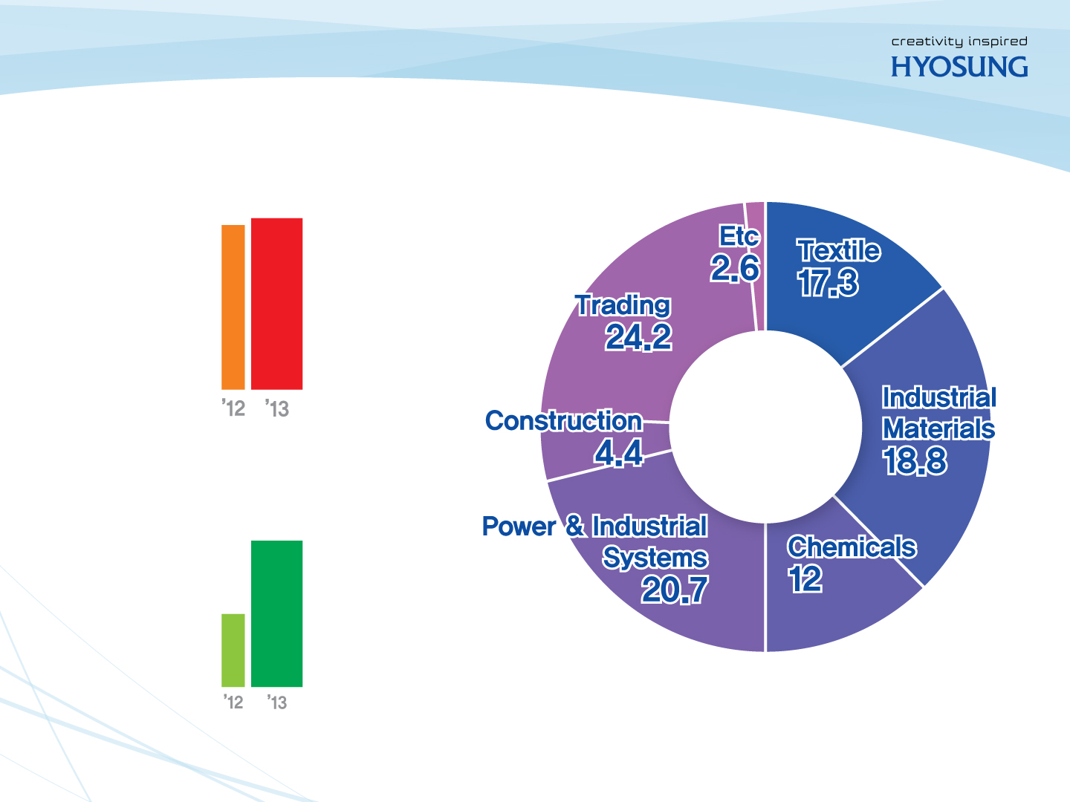
Hyosung Corporation
Total Sales (Textile)
Textile
17%
Trading & Others
25%
USD 2.4 Billion(‘18)
Sales Proportion by
Business Unit (%)
Global Hyosung
Industrial Material
19%
More than 65 locations
25,000 employees
Worldwide
Construction
9%
Power & Industrial system
18%
Chemicals
12%
Copyright © 2017 by creora®, Hyosung

Slide 3









Group Business Portfolio
Hyosung divided into a holding company and four business companies to make more focused and strategic decisions in each industry.
Strategy Center
Finance Center
Administration Center
Textile PG
Industrial
Materials PG
Chemicals PG
Power & Industrial
Systems PG
Construction
PG
Information &
Communication PG
Trading PG
Nylon·Polyester Fiber PU
Spandex PU
Fabric·Dyeing
PU
Tire & Industrial Reinforcements
PU
Technical Yarn PU
Global Safety Textiles
Interior PU
Aramid Business Division
Carbon Business Division
PP/DH PU
Film PU
TPA PU
Neochem PU
Optical Film PU
POK Business Group
Power Systems PU
Industrial
Machinery PU
HYOSUNG GOODSPRINGS PU
Wind Energy Business Division
Construction PU
Hyosung
Engineering PU
Chinhung International
Nautilus Hyosung PU
Hyosung Information
Systems PU
Hyosung ITX
Galaxia Electronics
Galaxia Communications
Galaxia Device
Steel & Metal Products PU I, II
Chemical Products PU
Hyosung Trans-World PU
LED Business Division

Slide 4

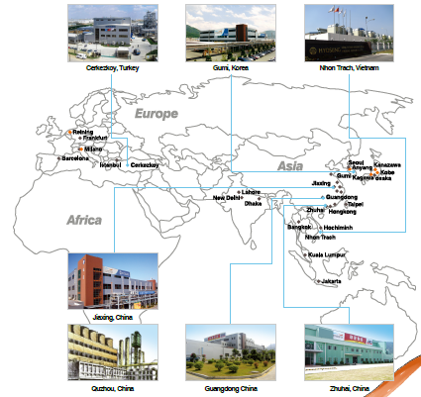

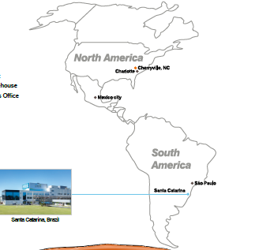

Global Network
9 production sites, 40 sales & marketing offices linking all continents
Auric, India
Notes:
Overall, I can tell you that Hyosung is the largest spandex manufacturer in the world with the brand name of creora.
And the world’s 7th market leader in Nylon fiber with over 40 years experience.
Also we’re one of the advanced polyester fiber producer in the world.

Slide 5

Hyosung Textile PG(Performance Group)
Largest manufacturer in world
Spandex
creora®
High power for shapewear & sportwear
Dyeable spandex for color vibrancy and fastness
Super chlorine resistance for swimwear
High quality product with 50 years experience
Nylon
Fiber
50+ years of accumulated production know-how
Wide array of aesthetic & performance fibers
First in the world to develop recycled fibers and microfiber
Advanced textile science for maximum comfort
Polyester
Fiber
Overseas expansion based on differentiated, high function fibers
First to develop recycled yarn using PET bottles( Regen)
M2 Aerocool, Askin selected as a first-class good worldwide
Notes:
Overall, I can tell you that Hyosung is the largest spandex manufacturer in the world with the brand name of creora.
And the world’s 7th market leader in Nylon fiber with over 40 years experience.
Also we’re one of the advanced polyester fiber producer in the world.

Slide 6

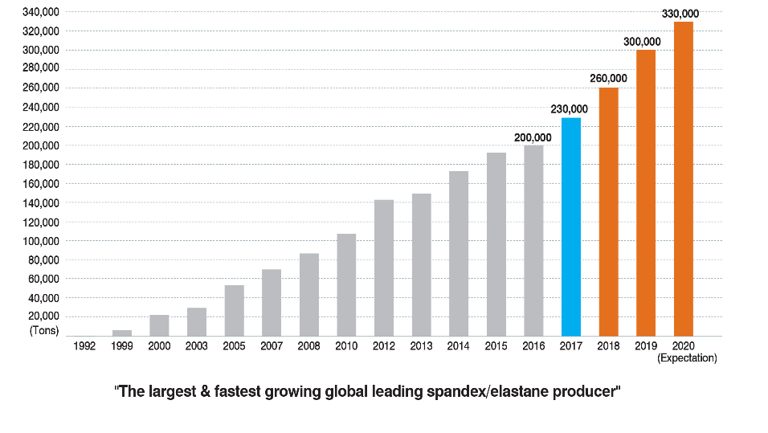

creora® Growth
creora® has increased capacity rapidly with great product quality.

Slide 7
Why creora® for Denim?
“Product has been qualified from global premium denim makers“
Market share is on the rise due to innovation and global marketing activities supporting our customer and brands.

Slide 8









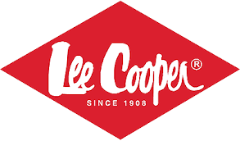



creora® users in Denim

Slide 9










Hyosung Offerings for Denim
Worldwide qualified product
With its premium quality
World most used product
Heat and chlorine resistance
Love nature with superior setting performance
Solution for warp stretch
Save the earth by energy saving
Extra comfort & perfect silhouette from 360˚ stretch
Great stretch with low shrinkage
Flattering fit without wrinkles
Keep Cool
with Comfort
Quick Absorption & Superior Wicking
Cool Touch Effect
Keep Fresh & Soft
with Lightweight
Great Wicking Performance
Light Weight & Softness

Slide 10

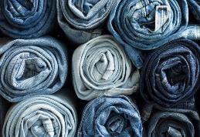
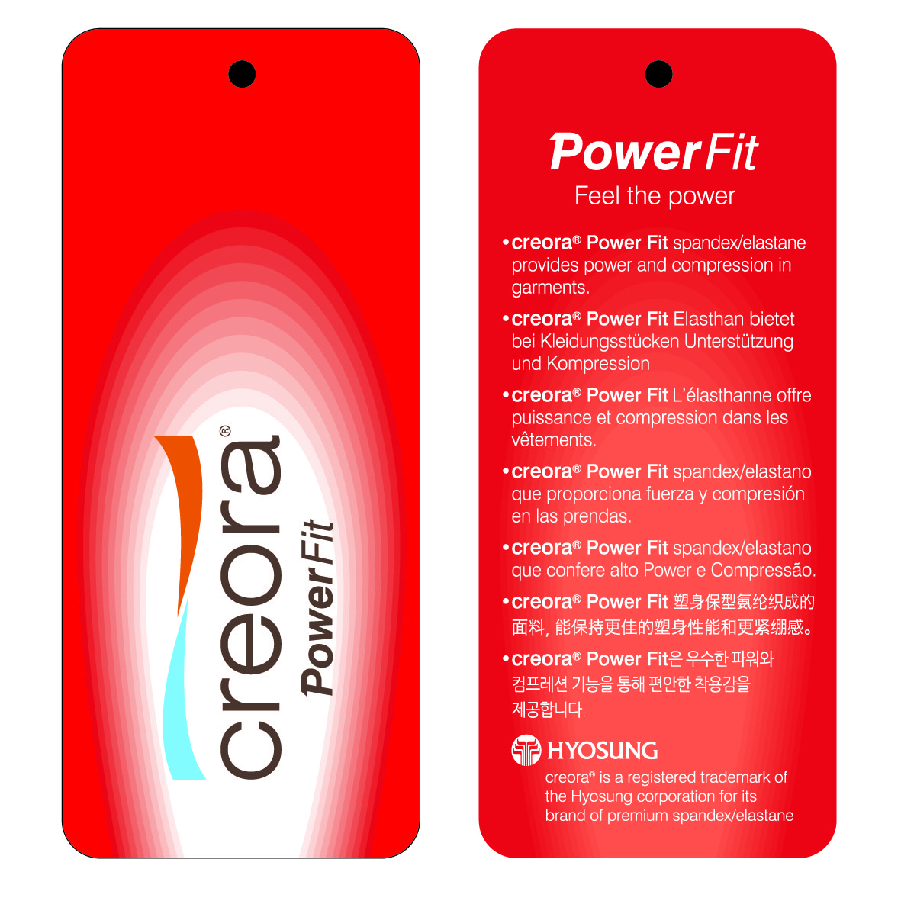
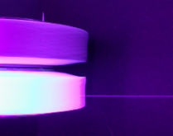
creora® Power Fit
“Worldwide Qualified Spandex”
Value
• Reliable partner for stretch fabric
World’s most used spandex with superior quality
Swift action with global technical service network
• Superior quality
Great heat resistance for stable production
Chlorine & bleach resistance for hard washes
[Offerings(de)]
20, 30, 40, 55, 70, 80, 90, 105, 120, 140, 210, 280
Fluorescence Power Fit prevent spandex missing &
de-centralizing in CSY
▶ CSY process: Minimize defect of core spun yarn
▶ Fabrics : Prevent from puckering & width problem
▶ Garments : Minimize quality problem in garment
[ spandex under UV light ]

Slide 11

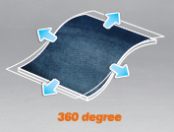
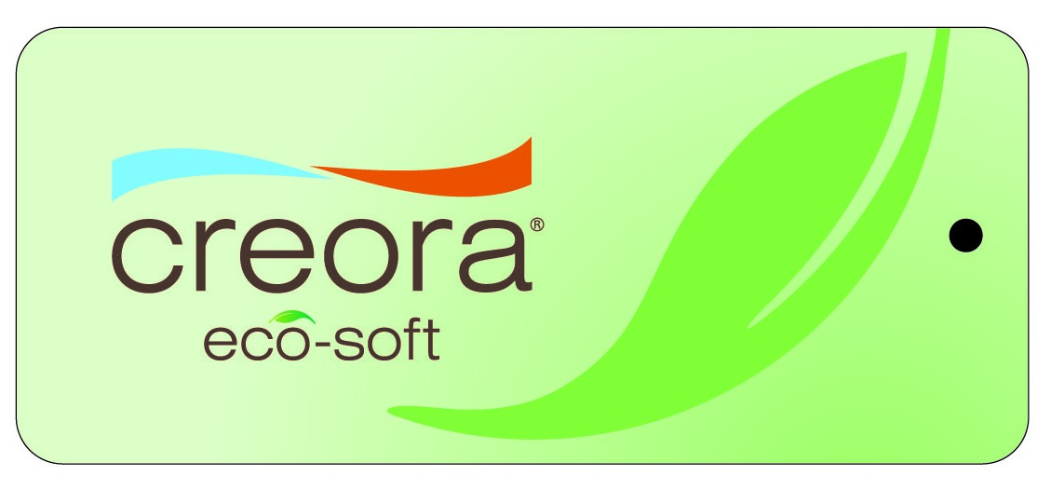

creora® eco-soft
“Love nature with superior setting performance”
Value
• Easy settable
Excellent setting performance
Good for authentic looking denim & 4way stretch denim with easy control of shrinkage
• Energy saving
Cost saving from lower heat setting temp.
Earth friendly by reducing energy consumption
[Offerings(de)]
20, 30, 40, 55, 70, 105

Slide 12

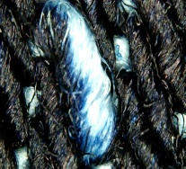
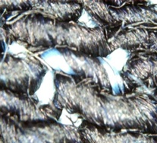
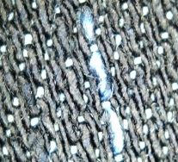
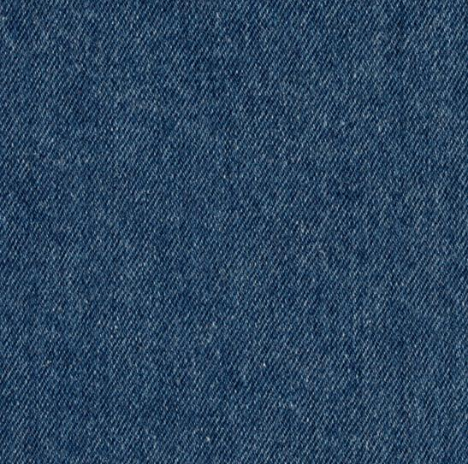
creora®
“Always Flattering Fit”
Value
• Extra ordinary comfort & Perfect silhouette
Second skin fit & extra comfort from 360˚ stretch
Perfect silhouette with great warp stretch
• Superior quality
Great stretch with low warp shrinkage
(prevent puckering at sewing part)
More clean look preventing defect (white spot) on the warp that is occurred when using dual core product
• Eco-friendly
Reducing energy with lower heat setting temperature
Features in warp direction
Cotton 10’s – 20’s
creora® eco-soft 40de – 70de
Stretch from 15% to 40%
(bi-component yarn has max. 15%)
Shrinkage under 10%
This data is based on ASTM D3107:2011, AATCC 135:2012 method (applied load:5lb). It may be different as per process condition.
Copyright © 2019 by creora®, Hyosung

Slide 13



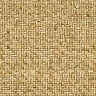
Cool Denim
x
“Keep Cool with Comfort”
ITEM | DEN/FILA | ACY Availability | INTERLACE
Nylon aqua-X DYT | 70/68 | O | Low Entangled (10ea/meter)
 | 70/68, 140/136 | X* | 100ea/meter
Polyester askin DYT | 65/72 150/72 | O | Low Entangled (10ea/meter)
 | 65/72, 130/144 | X | 100ea/meter
Value
• Superior quick absorption & Wicking
• Cool Touch Effect
<Cross section>
* Normal filament yarn with higher interlace (100ea/m)
can be used by conventional or double covering
_{Heat Transfer big}
_{Heat transfer small}
Bigger contact area
: Due to unique cross-section feature,
it offers bigger skin contact area to
absorb skin’s heat than regular yarn
Differentiated cross-section
helps moisture move and spread to
the outer layer of the fabric
Regular
Askin & Aqua-X
Small ◀ CONTACT AREA ▶ Big
heat
heat
SKIN

Slide 14
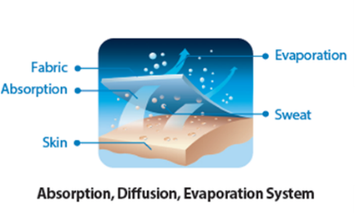
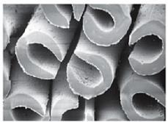
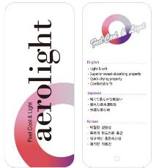
Light & Soft Denim
x
“Light weight with freshness & softness”
Value
• Ultra Quick Wicking
C shaped hollow core cross section gives Quick absorption & Fast drying and light weight
• Feel softness with high-multi filaments
ITEM | DEN/FILA | ACY Availability | INTERLACE
DTY | 65/144 130/144 | O | Low Entangled (30ea/meter)
 | 65/72, 130/144 | X* | 100ea/meter
<Cross section>
* Normal filament yarn with higher interlace (100ea/m) can be used by conventional or double covering
Notes:
Price around 6$/kg
Ramp Test method : from the 50cm distance, light 500w, during 15-20 min. around 2 degree could be increase.
Uniqlo already use this yarn in their fleece

Slide 15
Thank you

